Slide 1
SBND Subsystem Talk Example
Presenter Name [20pt Regular]
Director’s Progress Review of SBND
19-20 December 2016

Slide 2
Outline
Subsystem overview (design, scope and interface,2-3 slides)
Resource and management team (1slide)
Progress of design and fabrication (1-2 slides)
Technical reviews and responses (2 slides)
Schedule and cost summary (2 slides)
Deliverables and milestones (2 slides)
QA/QC and ESH (1slides)
Summary (1 slide)

Slide 3
Subsystem Overview
Design requirement
Wire pitch 3mm
Scope
Include subsystem pictures, drawings etc.
Interface and integration
Cold electronics interface
Cryostat Interface
Readout DAQ
Working with installation group/electronics/DAQ group…
Deliverables
List of deliverables for installation and integration

Slide 4
Resources
List key institutions and their responsivities
List of engineers, technicians and physicist
Funding sources: M&S and engineering team supports etc.
L3 WBS tasks and managers
L2 managers

Slide 5
Progress of Design and Fabrication
Summary of current design and fabrication status

Slide 6
Independent Technical Review
List of reviews held already and planned

Slide 7
Response to Review Recommendations
If there has been a technical review/assessment of the system, list the key recommendations and the action taken in response to key recommendations

Slide 8
Schedule , Cost and Milestones
Schedule and cost table
(Ask Ting for “standard ones” extracted from docDB 246 )
Task Name | Start | End | Cost
TPC Preliminary Design | 03/12/15 | 08/20/15
TPC Final Design | 10/01/15 | 11/30/16
APA Frame Fabrication - (UK) | 04/01/16 | 10/31/16
Geometry Boards - (US) | 12/01/15 | 12/29/16
APA Winding- (UK) | 09/06/16 | 07/07/17
APA Winding - (US) | 09/06/16 | 07/10/17
CPA Fabrication - (UK) | 08/04/16 | 08/17/17
Field Cage Fabrication - (US) | 08/04/16 | 08/17/17
HV and Feed-through - (US-UK) | 11/01/16 | 06/13/17

Slide 9
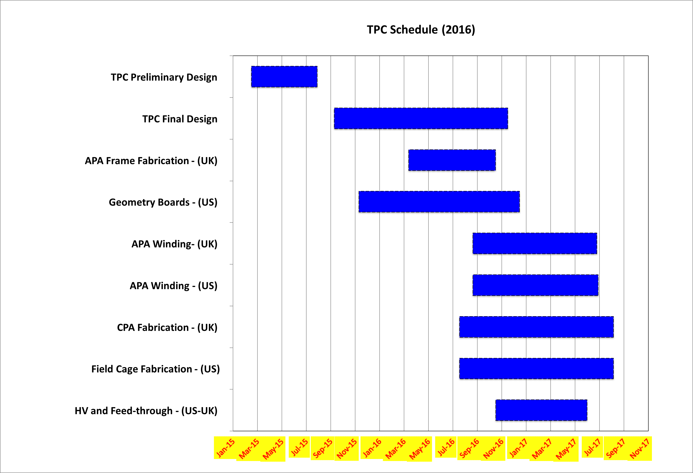
Schedule (ask Ting for excel plot)

Slide 10
Deliverable and Milestones
List of remaining deliverables and their milestones to FNAL for detector assembly and installation
Receiving and installation process
Resources need for assembly and installation

Slide 11
Risk and Mitigation
List of schedule and cost risk items
Wire-winding facility delays
HV feed-through
Cold test
Mitigation method

Slide 12
Fermilab Resource (DOE-only)
List of resource (labor and M&S) required for remaining tasks to completion
State resource coordination efforts with Fermilab

Slide 13
ES&H , Q/A
Quality Control and Assurance Program for this subsystem:
What tests are planned during fabrication
(e.g. wire tension, APA cold test)
What tests are planned at FNAL for assembly and installation
ES&H considerations for this subsystem:
How is safety documentation reviewed
What standards are used (e.g. ASME pressure vessel)

Slide 14
Summary
We done this and that
We expect to finish this and that
We worry about this
We will delivery those to SBND

Slide 15
Backup Slides

